Slide 1
Mathematics Assignment (Statistics)
Assignments 01 to 04
Submitted by: pooran pragnya
November batch (bds)

Slide 2
Assignment :01
Mean: It is the Average value of given observations.
It is given by the formula:
Example: Marks of Different 6 Students in a class
Marks: 65, 96,75,61,89,79
Mean = 65+96+75+61+89+79/6 = 77.5
Average Marks of 6 Students in a class = 77.5
Mean = sum of all values / Total number of values

Slide 3
Median: It is the Middle Value of given observation after sorting all the values in ascending or descending order.
Median is given by the formula:
For Even no of observations:
For odd no. of observations:
Example: Marks: 65, 96,75,61,89,79
(Arrange the numbers in Ascending or Descending Order)
Marks: 61,65,75,79,89,96, so Median = 75+79/2 = 77
Median = (n/2)^{th} + (n/2+1)^{th} /2 (term)
Median = (n/2)^{th} (term)

Slide 4
Mode: It is the value that appears most number of times in observation.
Example: Marks of Different 6 Students in a class
Marks: 65, 96,75,61,89,79
* In the given set of marks, no values repeats, so there is No Mode.
* Similarly, if two values repeat then the set is said to be Bimodal and if there are three modes then it Is called as Trimodal.

Slide 5
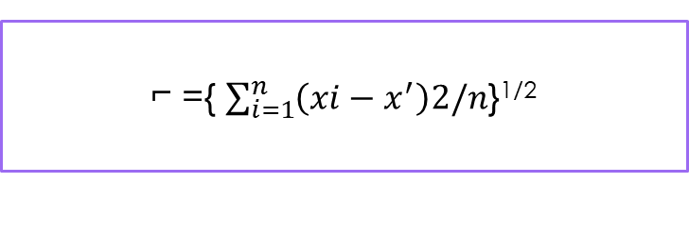
Assignment: 02
Standard Variation: It is a number that measures the dispersion of a dataset relative to its mean. i.e It is the number that describes how spread-out the values are.
It is represented by the symbol “⌐”
It is given by the Formula:
A low standard deviation means that most of the numbers are close to the mean value
A high standard deviation means that most of the numbers are spread-out to the mean value
⌐ ={ $\sum_{i=1}^{n}{\left(xi−x^{′}\right)2/n}$}^{1/2}

Slide 6
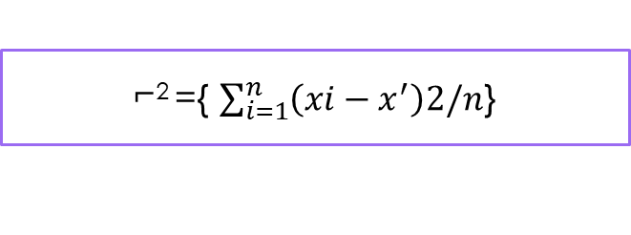
Variance: It is another number that indicates how spread-out the values are.
* It is represented by the symbol “⌐²”
It is given by the formula:
* It is square of standard Deviation.
⌐² ={ $\sum_{i=1}^{n}{\left(xi−x^{′}\right)2/n}$}

Slide 7
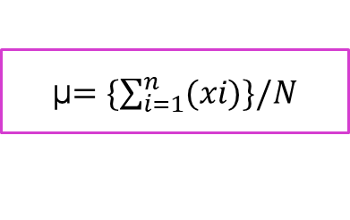
Assignment:03
Population Mean: It is the mean/average of all parameters of whole population used in study.
* It is represented by the symbol ‘µ’
It is given by the formula:
Where ‘N’ is Total population.
*Population: It is the collection of a specified group of similar objects, individuals or entities that have some common observable characteristics in them. Out of which each object is called as “Elementary Units”.
µ$=\{\sum_{i=1}^{n}{(xi)\}/N}$

Slide 8
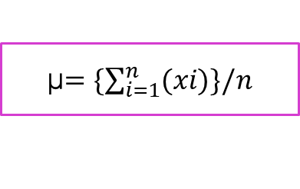
Sample : it is a subset of population used to study i.e it is a part of the population drawn according to a rule/plan for concluding characteristic.
Sample Size: The number of items in a sample is called sample size.
Sample mean: Average/mean of subset of population used to study is called sample mean.
*sample mean is given by the formula:
where ‘n’ is total number of items in a sample.
**Note: It is impractical to find the population mean so, sample mean is generally used to study the data.
µ$=\{\sum_{i=1}^{n}{(xi)\}/n}$

Slide 9
Assignment : 04
1. Given set of Data: 7, 11, 16, 14, 11, 13, 19, 13, 13.
Step 1: Arrange in Ascending Order:
7, 11, 11, 13, 13, 13, 14, 16, 19.
Mean = 7+11+11+13+13+13+14+16+19/9 = 117/9 = 13
Median = 13
Mode = 13

Slide 10
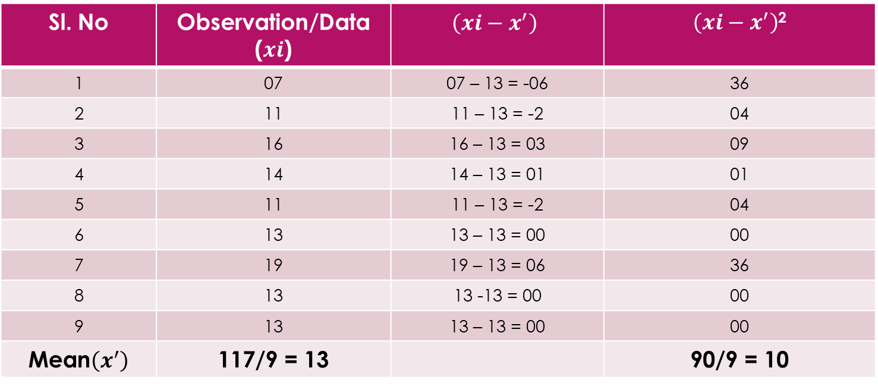
To Find Variance and Standard Deviation:
Sl. No | Observation/Data ($xi$) | $$\left(xi−x^{′}\right)$$ | $\left(xi−x^{′}\right)$²
1 | 07 | 07 – 13 = -06 | 36
2 | 11 | 11 – 13 = -2 | 04
3 | 16 | 16 – 13 = 03 | 09
4 | 14 | 14 – 13 = 01 | 01
5 | 11 | 11 – 13 = -2 | 04
6 | 13 | 13 – 13 = 00 | 00
7 | 19 | 19 – 13 = 06 | 36
8 | 13 | 13 -13 = 00 | 00
9 | 13 | 13 – 13 = 00 | 00
Mean$\left(x^{′}\right)$ | 117/9 = 13 |  | 90/9 = 10
Variance (⌐²) = 10
Standard Deviation (⌐) = 3.17

Slide 11
Assignment : 04
2. Given set of Data: 16, 15, 16, 17, 19, 12, 14, 09.
Step 1: Arrange in Ascending Order:
9, 12, 14, 15, 16, 16, 17, 19.
Mean = 9+12+14+15+16+16+17+19/8 = 118/8 = 14.75
Median = 15+16/2 = 15.5
Mode = 16

Slide 12
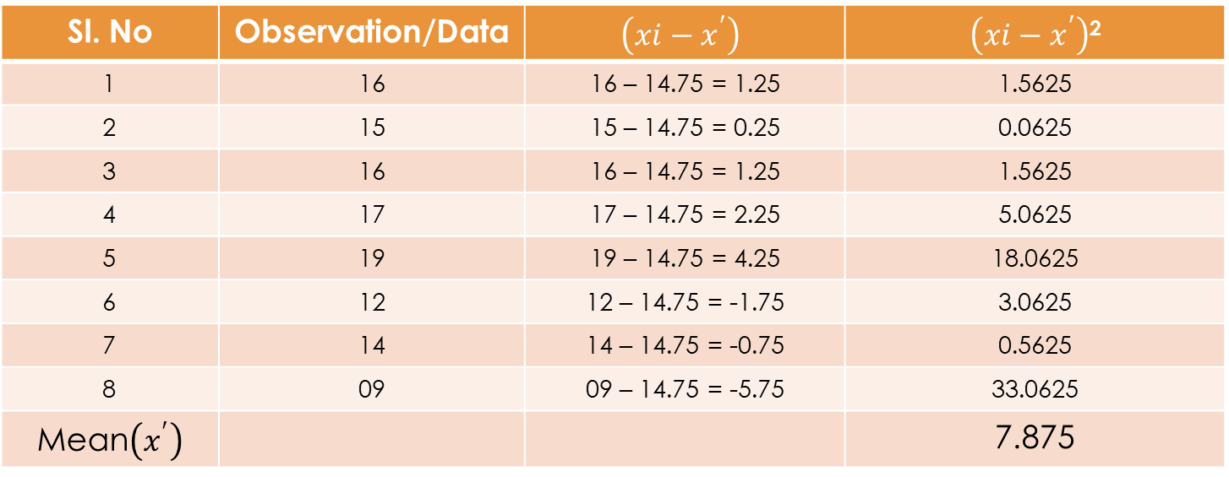
To Find Variance and Standard Deviation:
Sl. No | Observation/Data | $$\left(xi−x^{′}\right)$$ | $\left(xi−x^{′}\right)$²
1 | 16 | 16 – 14.75 = 1.25 | 1.5625
2 | 15 | 15 – 14.75 = 0.25 | 0.0625
3 | 16 | 16 – 14.75 = 1.25 | 1.5625
4 | 17 | 17 – 14.75 = 2.25 | 5.0625
5 | 19 | 19 – 14.75 = 4.25 | 18.0625
6 | 12 | 12 – 14.75 = -1.75 | 3.0625
7 | 14 | 14 – 14.75 = -0.75 | 0.5625
8 | 09 | 09 – 14.75 = -5.75 | 33.0625
Mean$\left(x^{′}\right)$ |  |  | 7.875
Variance (⌐²) = 7.875
Standard Deviation (⌐) = 2.806

Slide 13
Assignment : 04
3. Given set of Data: 27, 66, 24, 81, 50, 40, 74, 81, 97.
Step 1: Arrange in Ascending Order:
24, 27, 40, 50, 66, 74, 81, 81, 97.
Mean = 24+27+40+50+66+74+81+81+97/9 = 540/9 = 60
Median = 66
Mode = 81

Slide 14
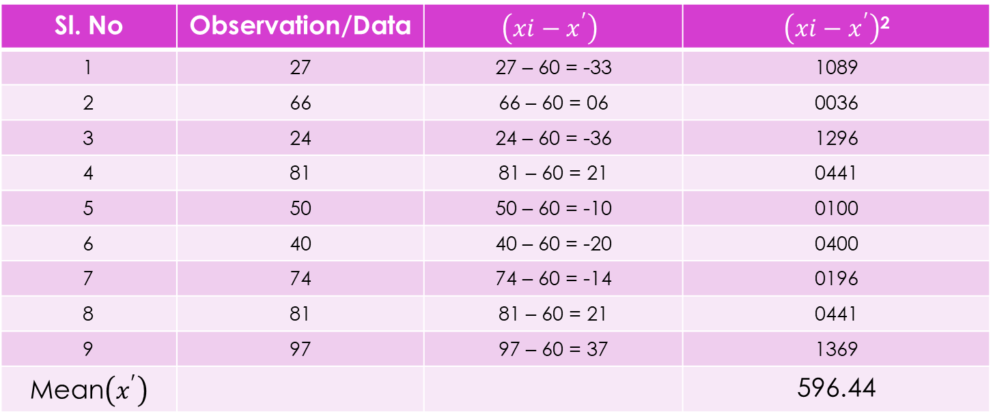
To Find Variance and Standard Deviation:
Sl. No | Observation/Data | $$\left(xi−x^{′}\right)$$ | $\left(xi−x^{′}\right)$²
1 | 27 | 27 – 60 = -33 | 1089
2 | 66 | 66 – 60 = 06 | 0036
3 | 24 | 24 – 60 = -36 | 1296
4 | 81 | 81 – 60 = 21 | 0441
5 | 50 | 50 – 60 = -10 | 0100
6 | 40 | 40 – 60 = -20 | 0400
7 | 74 | 74 – 60 = -14 | 0196
8 | 81 | 81 – 60 = 21 | 0441
9 | 97 | 97 – 60 = 37 | 1369
Mean$\left(x^{′}\right)$ |  |  | 596.44
Variance (⌐²) = 596.44
Standard Deviation (⌐) = 24.42

